Slide 1
Attitude detection based on head pose, facial expression and speech
Qingcai Cui
2018/9/5

Slide 2
Background
人们在表达态度的时候有时并不一定会使用语言，而可能使用肢体动作（点头或摇头）或面部表情（开心或沮丧）。
例如：
——你吃饭了吗？——（摇头）
——你有女朋友吗？——（一脸委屈）

Slide 3
scenario
RTS、未来的小冰
读心术
—— 你好呀，现在下班了吗？
—— （点点头）
—— 下班了我们去吃好吃的吧，你喜欢吃牛排吗？
—— （不情愿地摇头）
—— 啊那好吧，那你喜欢吃小龙虾吗？
—— （开心地点点头说喜欢啊）
—— 好，那就这么愉快地决定了！
—— 你先想好一个人的名字，然后我来问你一些问题。第一个问题，tA是男的吗？
—— （摇头）说不是啊
—— 她演过古装剧吗？
—— （点头示意）
….
—— TA是杨幂

Slide 4
Data FLOW
Input
HEAD POSE（头部动作——点头摇头）
FACIAL EXPRESSION（面部表情——开心沮丧）
SPEECH（语音信息——是、不是、好、不对等）
OUTPUT
Attitude（-1 to 1）

Slide 5
KNOWLEDGE
LandMARK
HEAD Pose
Facial EXPRESSIOn
SPEECH

Slide 6

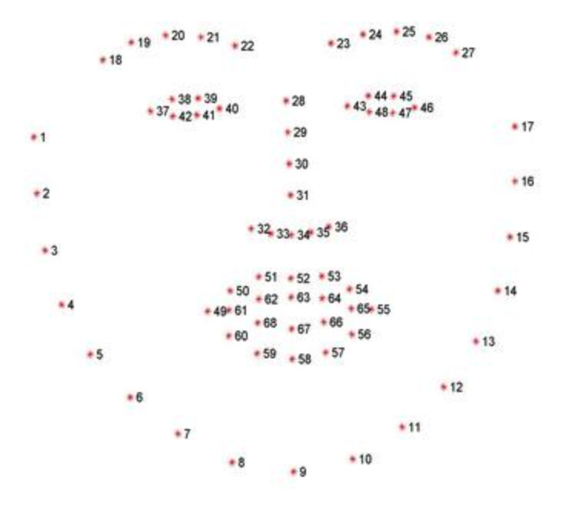
LANDMARK INTRODUCTION
特征点数量: 68
位置：脸颊轮廓、眉毛、眼睛、鼻子、嘴巴
详细分布：眉毛2x5、鼻子4、眼睛2x6、上嘴唇12、下嘴唇8、牙齿3、脸颊轮廓17、鼻子下方5
作用：标识脸部轮廓及五官位置

Slide 7
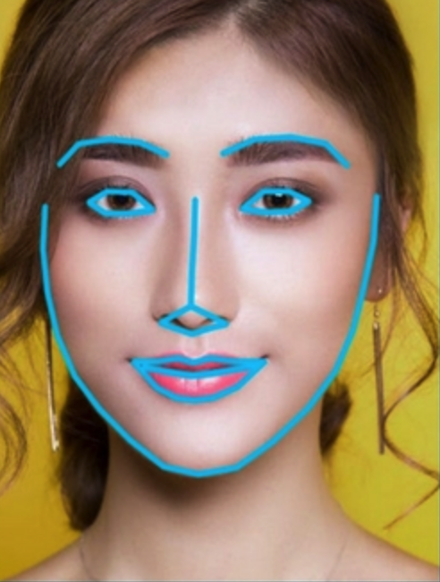
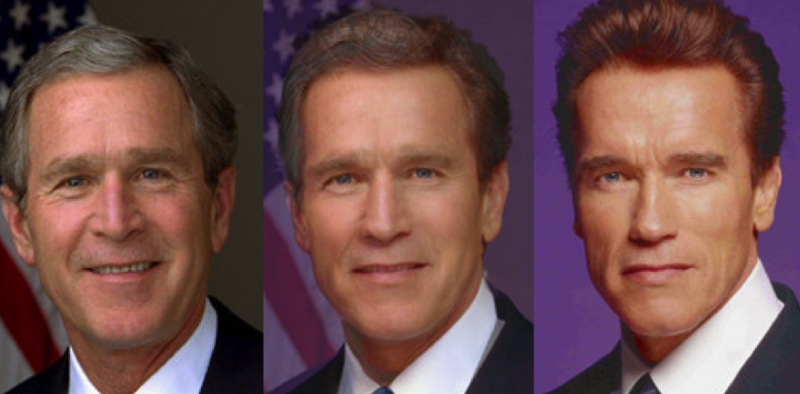
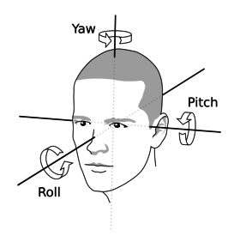
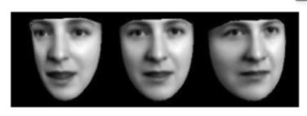
USAGE OF LANDMARK
Face Recognition
Face Morphing
Head Pose Estimation
Eye gaze tracking

Slide 8
LANDMARK detection solutions
Holistic Methods
Build models to represent the global facial appearance and shape information
Pool performance and slow speed
2. Constrained Local Model (CLM)
Build models to leverage the global shape model but local facial appearance
Good performance and medium speed
3. Regression-based Methods
Build models to implicitly represent the facial shape and facial appearance.
Including deep-learning methods
Excellent performance and fast speed.

Slide 9
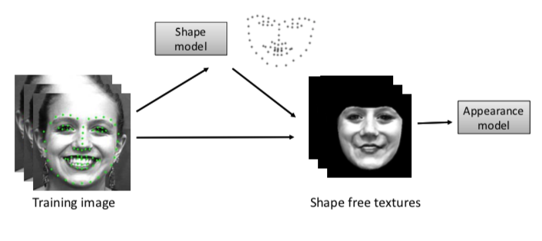
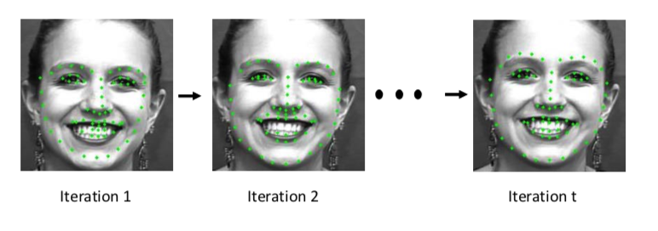
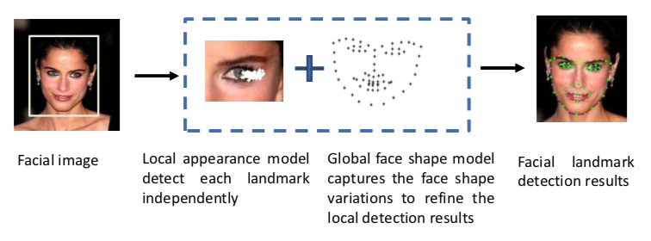
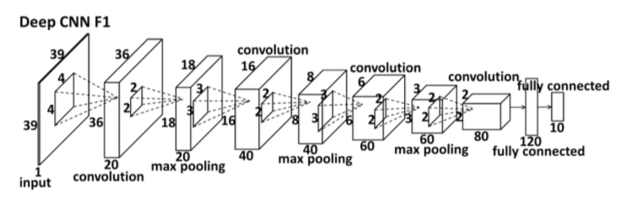
LANDMARK detection solutions
Holistic Methods (AAM)
Cascaded Regression Model
Constrained Local Methods (CLM)
Deep-learning Regression Model
Notes:
AAM，统计学模型，控制表情和轮廓的误差来拟合面部图像。改进：+ Feature Representation or Ensemble such as Boosting or Bagging.
CLM，专门对某局部信息进行信息识别，然后再结合轮廓和位置信息，最终组合形成 Landmark

Slide 10
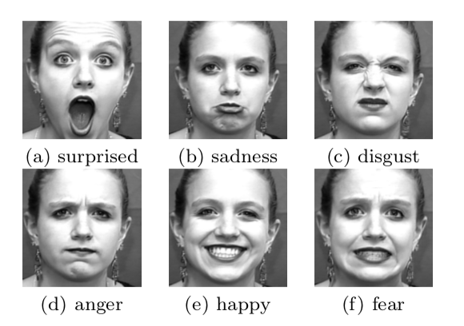
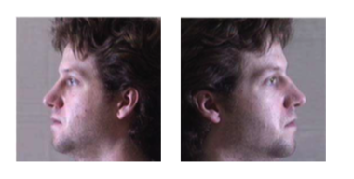
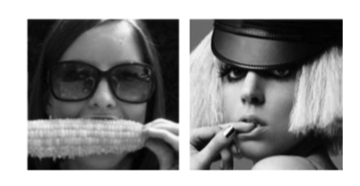
LANDMARK Difficulty
Extreme head pose
Occlusion
Expression

Slide 11
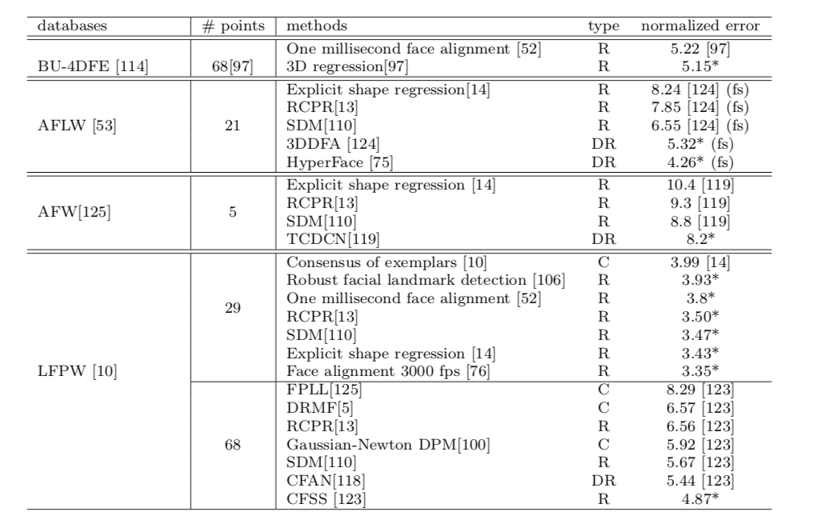
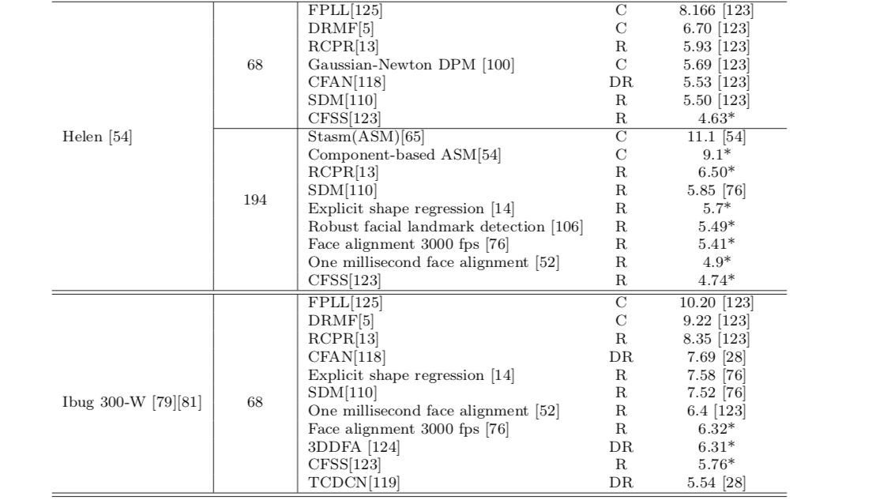
LANDMARK Datasets and solutions
Datasets and Model Performances:

Slide 12
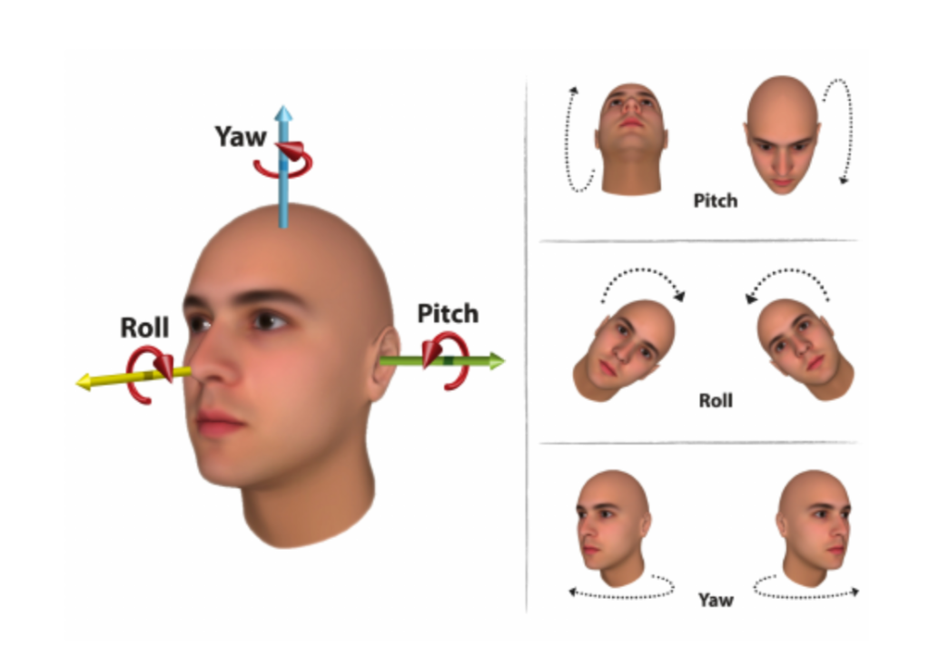
Head Pose
Categories：
1. Pitch
2. Roll
3. Yaw

Slide 13
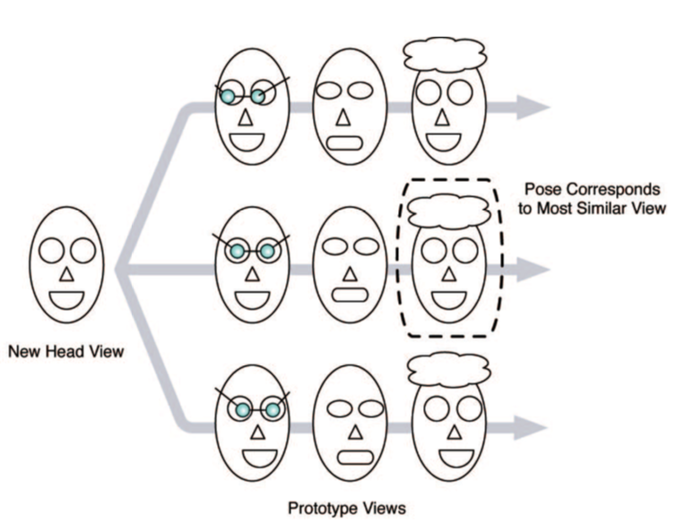
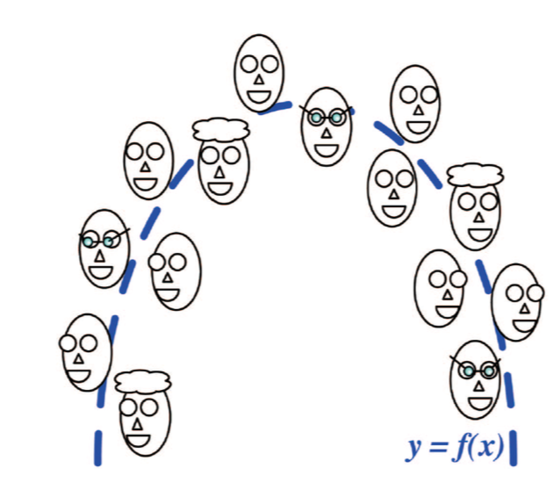
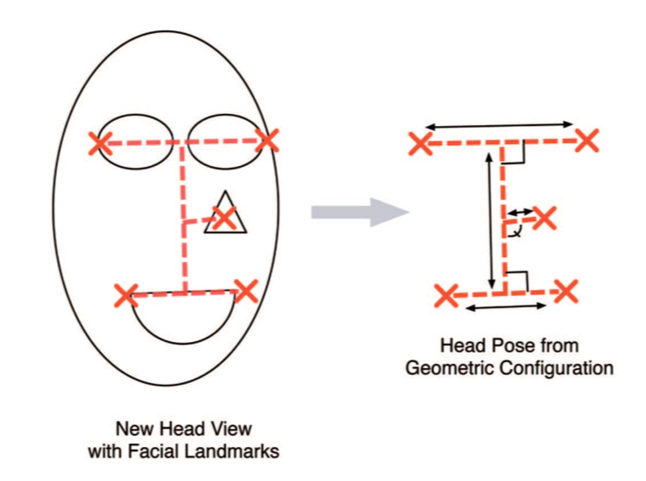
Head Pose solutions
Compared with Templates
Bad performance
Regression Model
Including Deep-learning
Good Performance
Model with Landmark
Good Performance
Much more convenient

Slide 14
Head Pose Dataflow
Perspective-n-Point (PNP Algorithm)
Input:
Landmarks and 3D Model Points
Output:
Translation Information
3-D (x, y, z)
Rotation Information:
3-D (x, y, z angle)
3x3 Transform Matrix

Slide 15
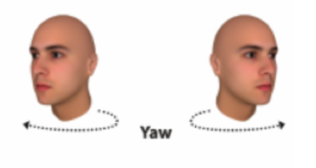
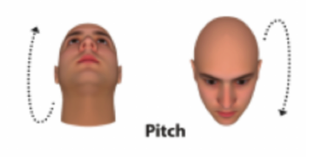
Head Pose FOR OUR Project
Negative
Positive

Slide 16
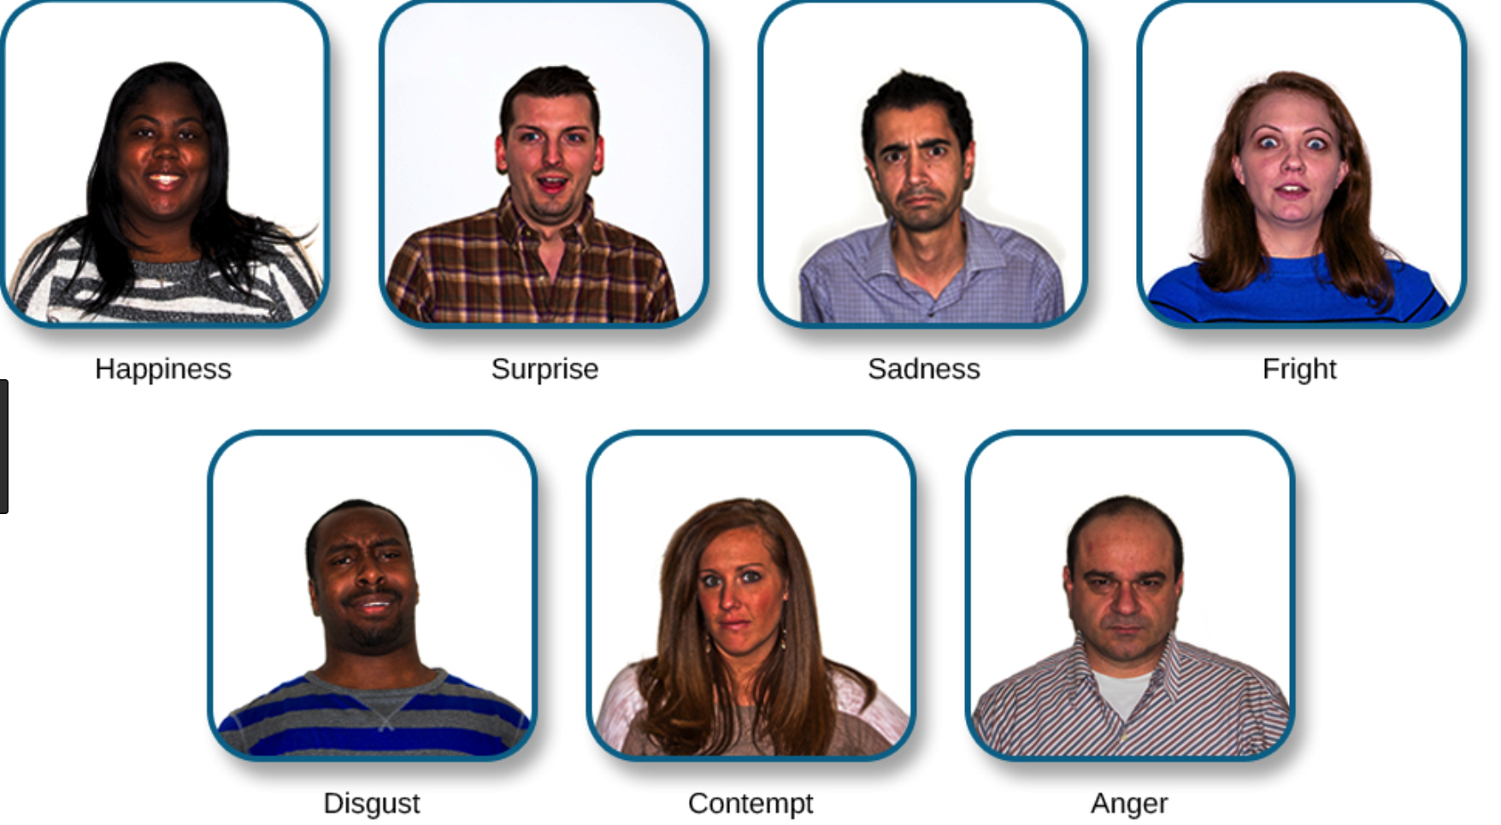
Facial Expression
Main 6 Categories:
Happiness, Surprise, Sadness,
Fright, Disgust, Anger
Contempt was added later.
Facial expression recognition (FER)

Slide 17
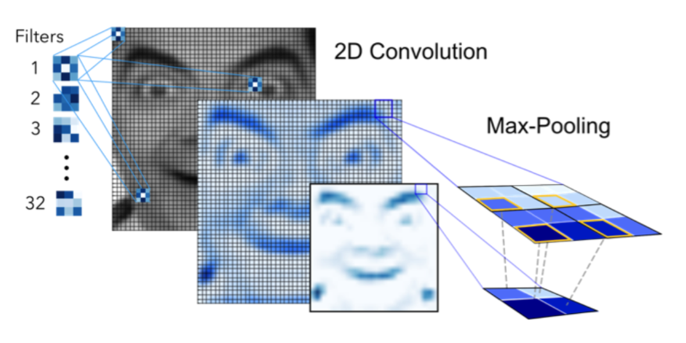
FER solutions
Traditional Methods
handcrafted features or shallow learning
e.g, local binary patterns (LBP) , LBP on three orthogonal planes (LBP-TOP), non-negative matrix factorization (NMF) and sparse learning
Bad Performance
2. Deep-learning Methods
Based on CNN
Good Performance

Slide 18
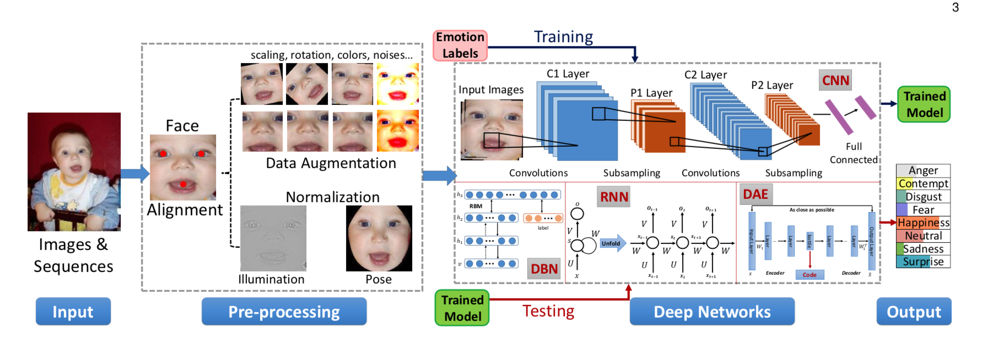
FER Steps
Preprocess
Face Alignment (Remove background and non-face areas) 移除凌乱背景
Data augmentation (Add random perturbations and transforms) 数据扩充、增加变换和随机扰动
Normalization (Process Illumination and Pose) 去重光照、姿态影响
2. Deep Models
DBN, DAE, etc

Slide 19


FER for OUR PROJECT
Positive
Negative

Slide 20
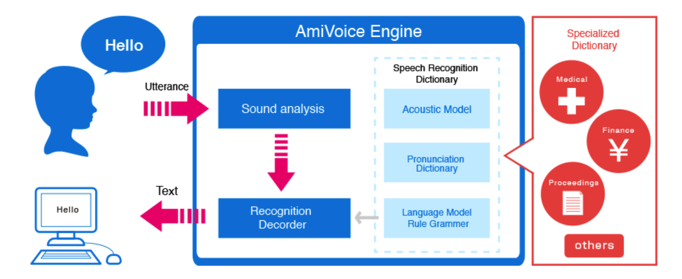
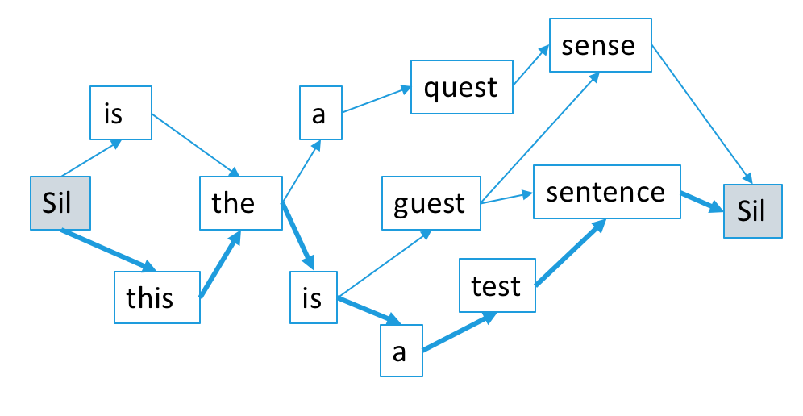
SPEECH recognition
Data Flow:
Utterance
-> Acoustic Model
-> Language Model
-> Text (Nbest, Confidence, Lattice)
Key:
Acoustic Model represents the likelihood of assigning a sequence of feature vectors to a given phoneme.
Lattice represents the probable language graph path of a given speech

Slide 21
SR for our project
N Best:
[{
‘text’: ‘不是啊’
}, {
‘text’: ‘是啊’
}, {
‘text’: ‘我是啊’
}]
Audio (不是啊)
Negative

Slide 22
Joint learning
Head Pose
Facial Expression
Speech
Attitude
Sorry, we are the first one to do this.

Slide 23
LET‘S GO

Slide 24
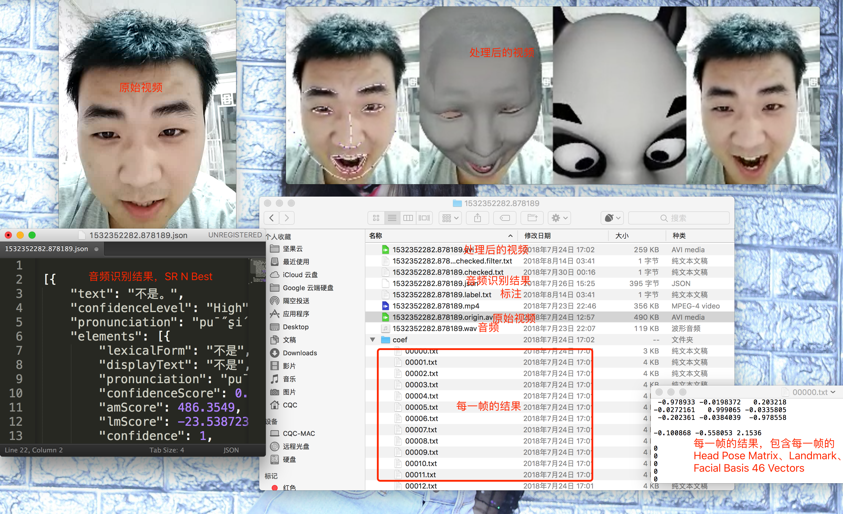
3D Track API
Input:
Video
Output:
Landmark
Head Pose Transform Matrix
Facial Expression 46 Basis Vectors

Slide 25

Version 1
Collect Video of Head Pose and Facial Expression (No Speech)
Split Video to Segment
Label Video to Positive/Negative Attitude
3D Track API
Use the Head Pose Transform Matrix(Head Pose) and Basis 46 Vectors (Facial Expression) to detect attitude

Slide 26
Version 1
Positive
or
Negative
Transform Matrix Std
46 Basis Vectors

Slide 27
Version 1
Accuracy: 0.8125
Report precision recall f1-score support
no 0.83 0.87 0.85 23
yes 0.78 0.93 0.85 15
avg / total 0.82 0.81 0.80 48
准确率：81.25%
总体 F1: 0.80
个人录制的视频，基本无干扰，对于点头摇头识别较好。
对于表情识别一般。
无声音信息，可扩展性不够。

Slide 28

Version 2
改用读心术，通过读心术来让
用户自然表达正负态度，
同时收集用户数据。
为此制作了一个读心术系统：
https://readheart.cuiqingcai.com/

Slide 29
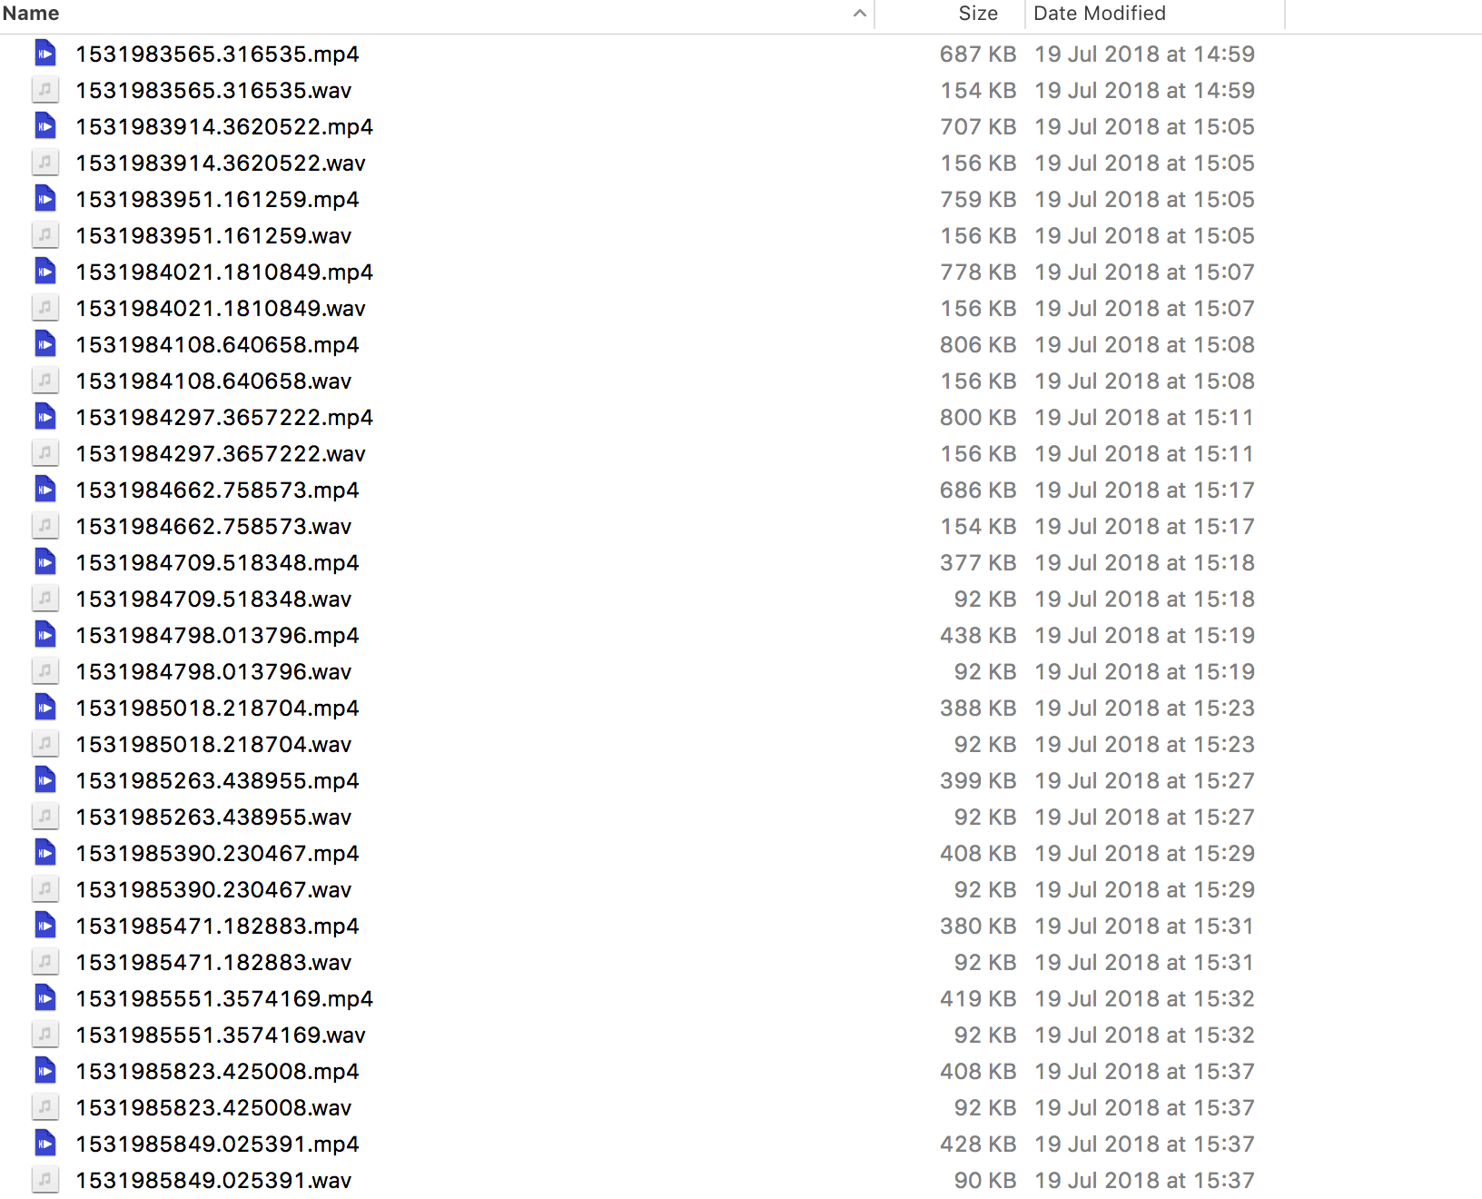
Version 2
收集了数千用户数据，每条数据包括一个视频和对应音频。
视频包含了用户回答时的动作及表情（如点头摇头、开心沮丧）。
音频包含了用户回答时可能说的话（是、不是、有、没有、对、不对等等）。

Slide 30
Version 2
Basis 46 Vectors Mean (46-d)
Head Pose Transform Matrix Mean(9-d)
Head Pose Transform Matrix Std (9-d)
Speech(2-d)
SVM
Attitude
Dataset V1, Total 1583, 317 for Test
Accuracy: 0.8012618296529969
Report precision recall f1-score support
no 0.80 0.90 0.85 196
yes 0.80 0.64 0.71 121
avg / total 0.80 0.80 0.80 317
态度 | 个数 | 比例
是 | 999 | 62.7%
否 | 584 | 36.6%

Slide 31
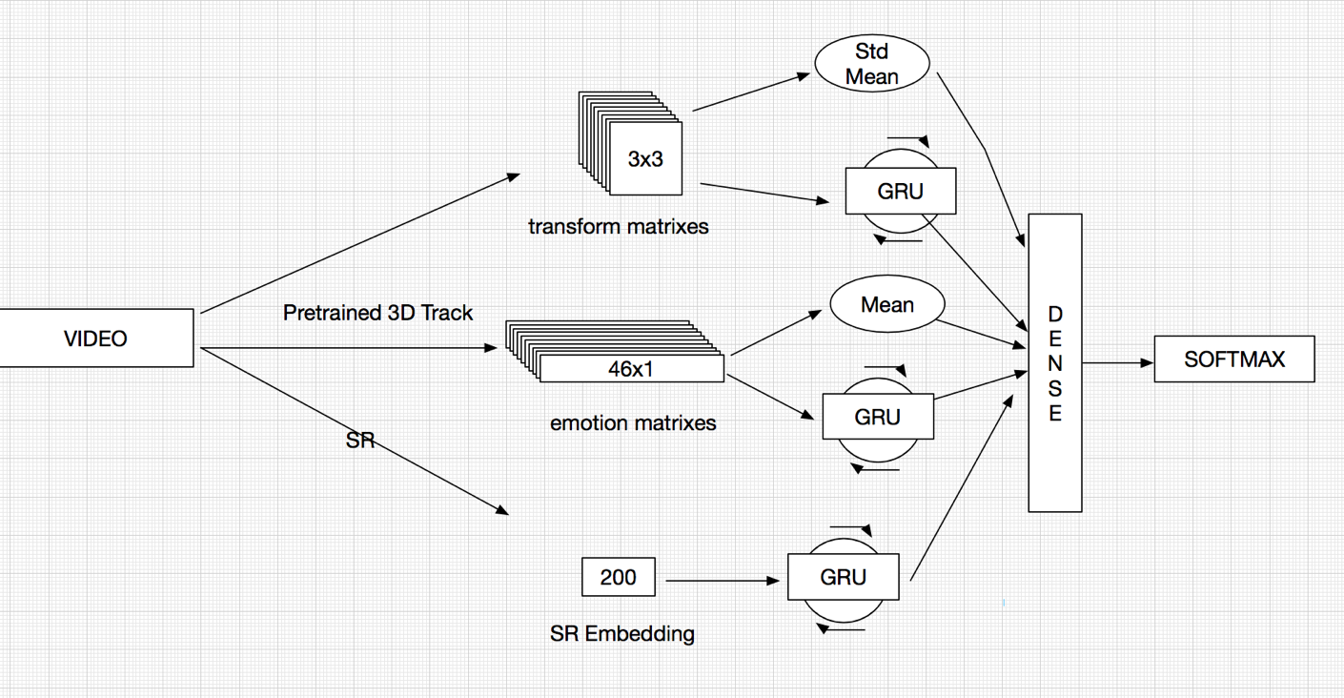
Version 2
Accuracy: 0.8107255520504731
Report precision recall f1-score support
no 0.87 0.85 0.86 216
yes 0.70 0.72 0.71 101
avg / total 0.81 0.81 0.81 317
尝试深度学习模型，Transform Matrix 和 Facial 46 Basis Vectors 用GRU处理，同时加入方差和均值数据。

Slide 32
Version 2
数据存在问题：
有的人在表达态度的时候不点头或者摇头，只说话（是、不是、对、不对等），表情还很僵硬，所以识别 Yes Or No依赖的就只有SR结果了。
对于这种Case，我们仅能依靠SR识别得到最终结果，但是SR结果却是乱的，转移矩阵和表情也没有有效信息，但是我根据原始视频观看结果还给了标注，相当于输入都是无效数据，输出有Label，所以模型不可能学到任何结果，这种数据有严重噪声。

Slide 33
Version 3
Dataset V2, Total 1581, 317 for Test
态度 | 个数 | 比例
否 | 1031 | 65.2%
是 | 550 | 34.8%
Deep Model
Accuracy: 0.9211356466876972
precision recall f1-score support
no 0.94 0.94 0.94 216
yes 0.88 0.87 0.88 101
avg / total 0.92 0.92 0.92 317
SVM
Accuracy: 0.8927444794952681
Report precision recall f1-score support
no 0.91 0.94 0.92 216
yes 0.86 0.79 0.82 101
avg / total 0.89 0.89 0.89 317

Slide 34
Version 3
存在问题：
现有系统中并没有集成3D Track API，因此需要脱离 3D Track API 进行尝试。

Slide 35
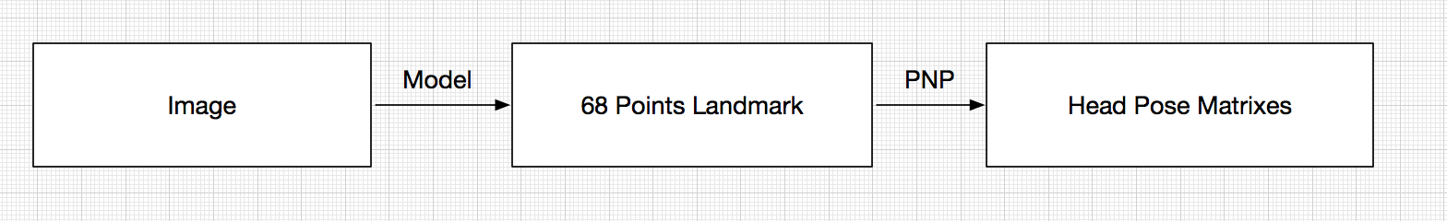
Version 4
由于目前数据量不大，直接训练效果不佳。
因此采取 Pretrain + Fintune 的方式进行处理。
Head Pose:

Slide 36
Version 4
300-VW
IBUG
LFPW
Total Number: 22w
AFW

Slide 37
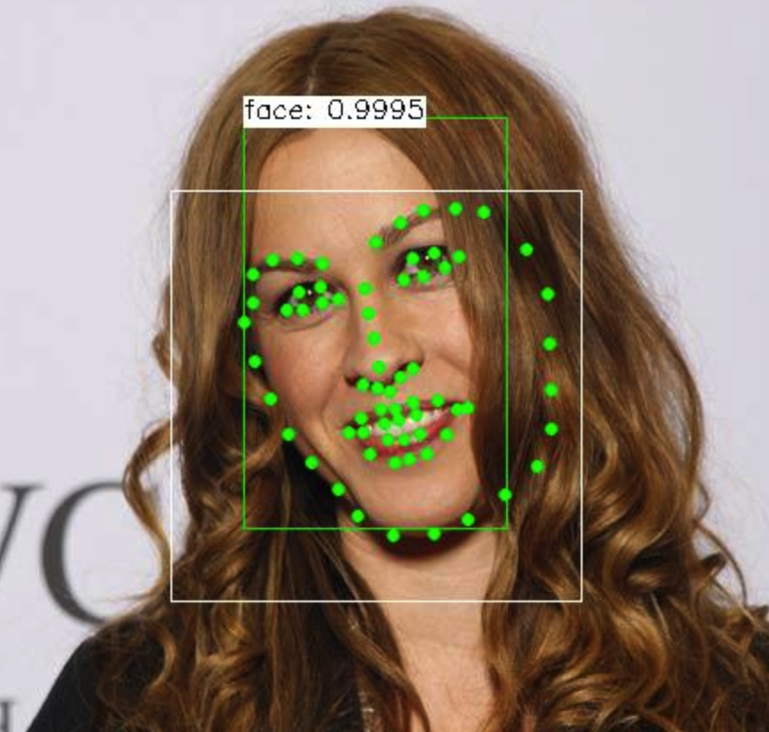
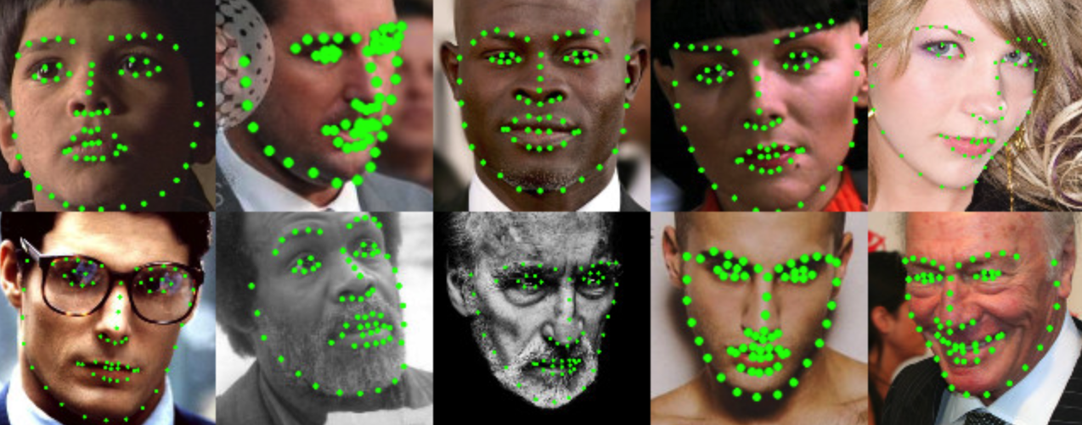
Version 4
Preprocess: Get Face Area according to Landmark
Preprocessed Result

Slide 38
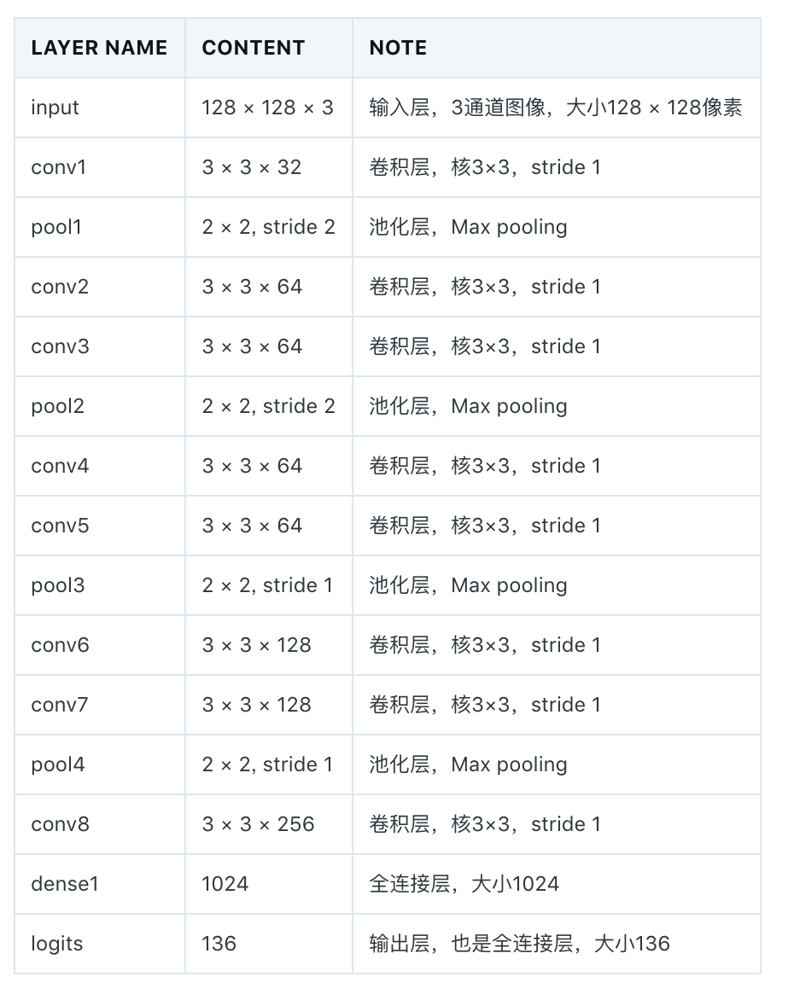
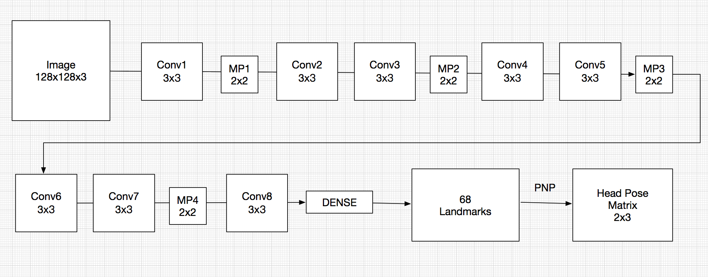
Version 4
经过8层卷积及四层池化，最终输出68个Landmark
进行Pretrain。
然后经过PNP算法，输出 Head Pose Matrix。

Slide 39
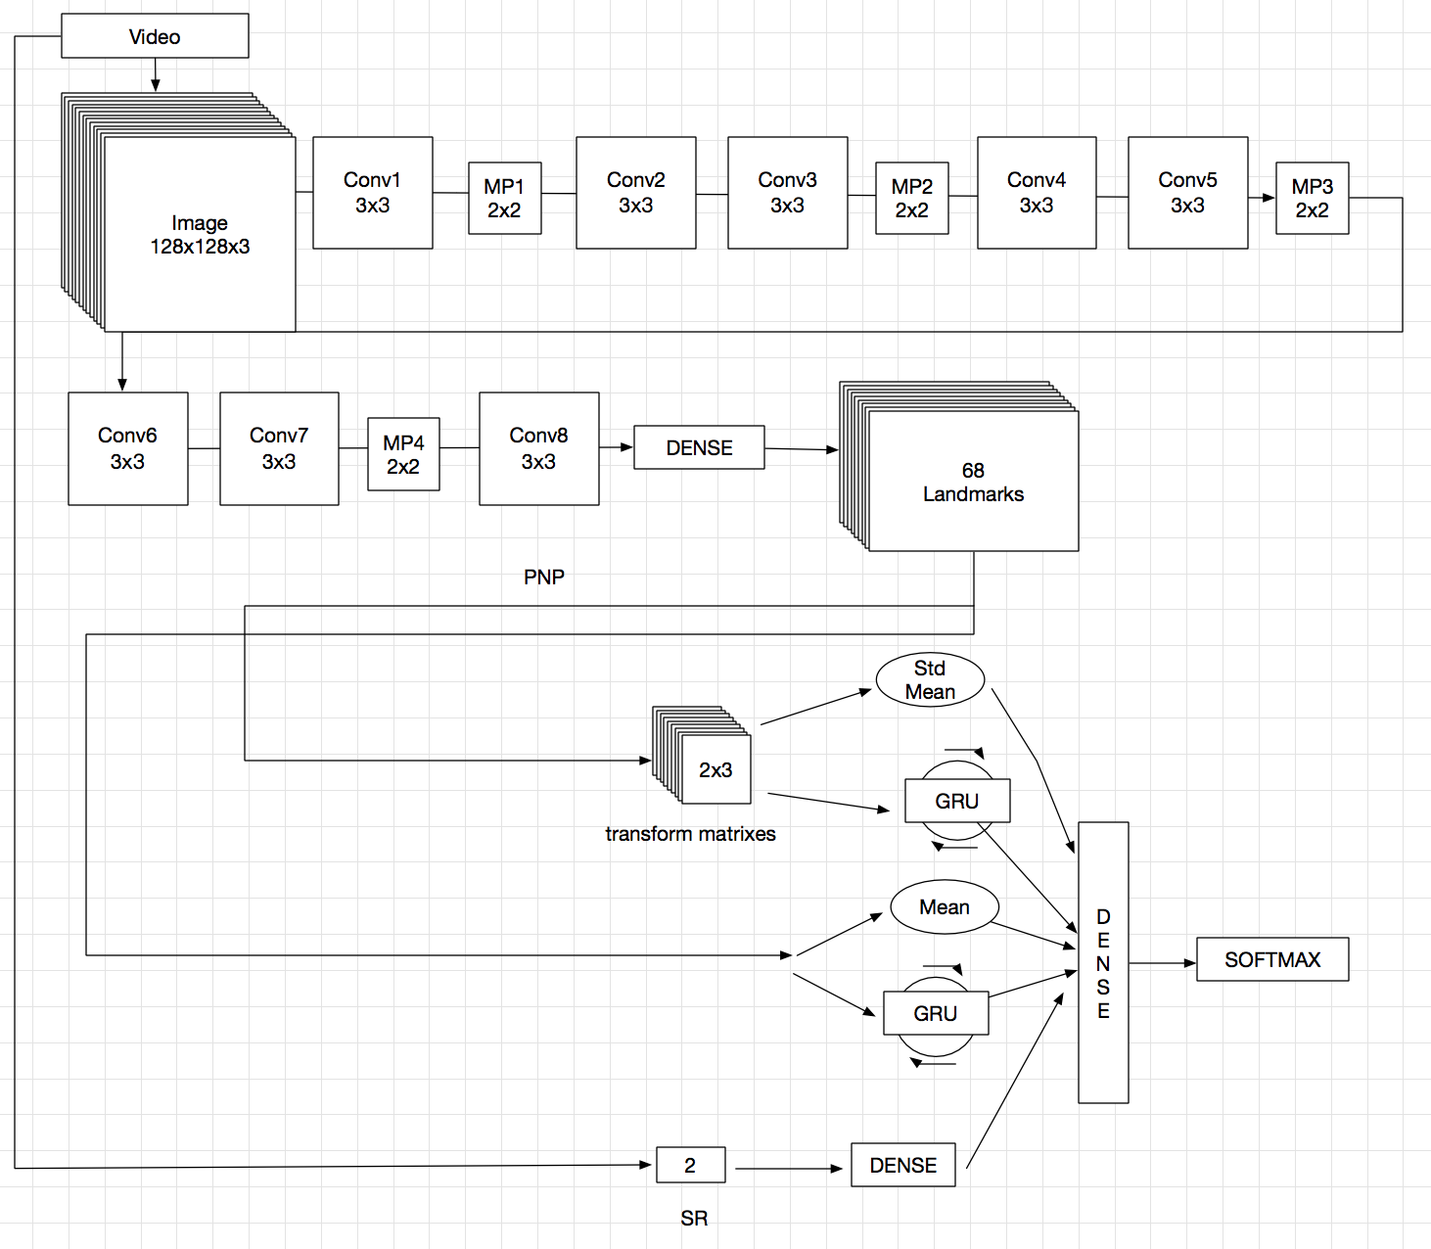
Version 4
使用上面的模型在新的数据集上 Fintune，
Landmark 利用 PNP 算法转为 Head Pose Matrix，其他不变。
Accuracy: 0.9055555555555556
Report precision recall f1-score support
no 0.90 0.95 0.93 111
yes 0.92 0.83 0.87 69
avg / total 0.91 0.91 0.90 180

Slide 40
Version 5
Accuracy: 0.9111111111111111
precision recall f1-score support
no 0.96 0.89 0.93 111
yes 0.84 0.94 0.89 69
avg / total 0.92 0.91 0.91 180

Slide 41
Thanks for your time!

Slide 42
REFERENCES
[1] Ines Sophia Rieger, Head Pose Estimation using Deep Learning, 2018
[2] Yue Wu, Simultaneous Facial Landmark Detection, Pose and Deformation Estimation under Facial Occlusion, 2018
[3] Shan Li, Deep Facial Expression Recognition
[4] Yue Wu, Facial Landmark Detection: a Literature Survey
[5] Vicent, Head Pose Estimation via Probabilistic High-Dimensional Regression
[6] S. Sabanovic, M.P. Michalowski, and R. Simmons, Robots in the wild: Observing human-robot social in- teraction outside the lab
[7] M. A. Goodrich and A. C. Schultz, “Human-robot inter- action: A survey,” Found. Trends Hum.-Comput. Inter- act., vol. 1, no. 3, Jan. 2007.
[8] L. Tran, X. Yin, and X. Liu, “Disentangled representation learning gan for pose-invariant face recognition,” in Proceedings of the IEEE Conference on Computer Vision and Pattern Recognition, 2017, pp. 1415–1424.
…

